Slide 1

Reproductive education

Slide 2

Statistics
As many as 500 million people who experience menstrual cycles lack menstrual products and proper hygienic facilities
that 1 in 4 students in the United States have at one point been unable to obtain menstrual products
683,000 individuals who menstruate were financially prevented from affording the products that needed
only 38 percent of high schools and 14 percent of middle schools across the country teach all 19 topics identified as critical for sex education by the Centers for Disease Control and Prevention
34.8% of girls in rural areas of Colombia had zero knowledge of menstruation before having their first cycle
https://goauntflow.com/blog/the-impact-of-period-poverty-on-students/

Slide 3
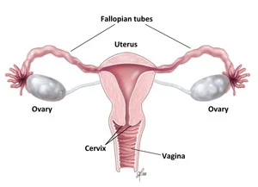
The menstrual cycle
A cycle that repeats every 24-38 days as the uterus sheds its lining
Averages 28 days
Average length of a period three to seven days
This cycle is driven by hormones
The uterine lining is abuilding up of tissue within the uterus that thickens to prepare the body for possible pregnancy
https://my.clevelandclinic.org/health/articles/10132-menstrual-cycle

Slide 4
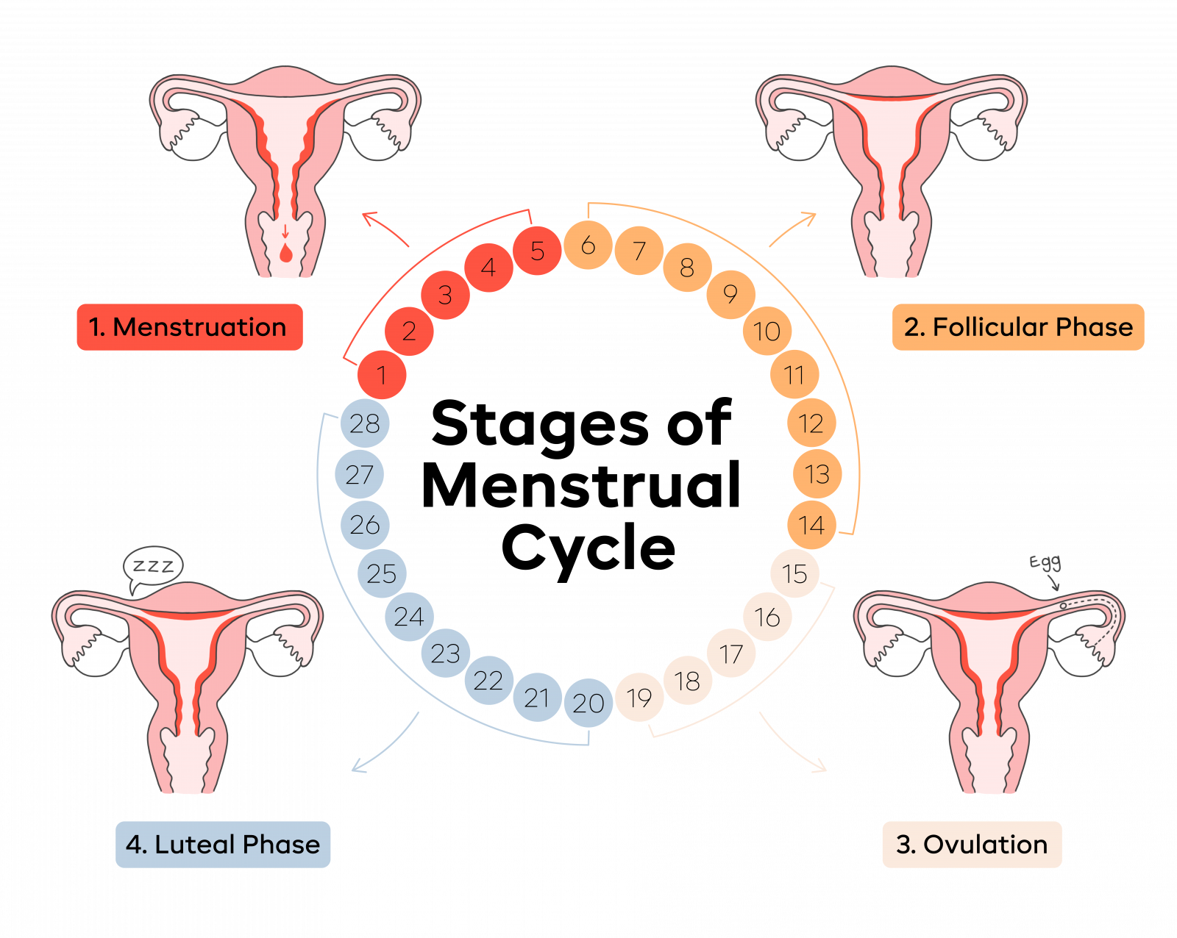
https://goauntflow.com/blog/4-stages-of-the-menstrual-cycle/

Slide 5
Phases of Menstrual Cycle
Menstrual/Period Phase
Follicular Phase
Ovulation Phase
Luteal phase

Slide 6
Menstrual phase
Day ~1 to 5
Uterine lining is shed
Results in bleeding; bleeding looks different for everyone
Bleed from 3 to 7 days on average

Slide 7
Follicular phase
Day ~6 to 14
Estrogen levels rise
Uterine lining begins to grow
Follicle-stimulating hormone is released helping to cause follicles to develop into mature eggs that can be fertilized
Day ~10 to 14 a mature egg is produced

Slide 8
Ovulation phase
Day ~14
Shorter window of time for peak fertility as the egg is only highly fertilizable through a small range on positions within the uterus and fallopian tubes
The egg is release due to increase in Luteinizing hormone

Slide 9
Luteal phase
Day ~15 to 28
Egg has left fallopian tubes and descends to the uterus
Progesterone (hormone) levels rise; this halts further uterine lining growth caused by estrogen (Hormone) and allows the lining to mature and egg to implant
Egg only implants if it has been fertilized
If no egg implantation the cycle repeats starting again with the menstrual cycle

Slide 10
Normal period Symptoms
Premenstrual syndrome
feeling bloated
breast tenderness
mood swings
feeling irritable
Low sex drive/ loss of libido
During Menstruation
Abdominal cramps
Acne breakouts
Tender breasts
Fatigue
Bloating
Bowel movement issue
Headache
Mood swings
Lower back pain
Trouble sleeping

Slide 11
Period Products Breakdown- Disposable Pads
Made of absorbent material
Attach to the inside of underwear
Come in different size that related to the flow of blood one is experiencing from mini to super/ light to heavy
Can come with scented material however there is a risk for allergy
Should be changed every 3 to 4 hours even if pad seems like it can be used longer
In order to prevent infection and health issues from bacteria
Cost is about 40$ a month for boxes of pads

Slide 12
Period Products Breakdown- Reusable pads
Made from an absorbent material
Attaches to the inside of underwear
Can be reused multiple times after it can be thoroughly cleaned and washed
Can help to save money and is better for the environment as it reduces waste
Cost is roughly 20$ per reusable pad

Slide 13
Period Products Breakdown- Tampons
Made of absorbent material
Absorbs blood from inside the vagina; blocking the flow
Come in different sizes dependent on flow; light to heavy
Can come with odor reducing deodorants but these can be risky due to possible allergies
Many come with plastic or cardboard applicators hover some require the user to insert the tampon themselves
Tampons should be changed every 4 to 6 hours no matter the flow level
Tampons should not be left in for extended periods of time as they can increase the risk of toxic shock syndrome

Slide 14
Toxic Shock Syndrome (TSS)
Symptoms include high fever, rapid reduction in blood pressure, diarrhea, headache, sun-burn like rash, muscle aches
Caused by 2 types of bacteria that enter the body through a wound:
1. Staphylococcus aureus
2. Streptococcus pyogenes
If not treated TSS can cause organ failure and seizures; ultimately TSS can be deadly

Slide 15
Period Products Breakdown- Menstrual cups
Made of body-safe material that is reusable
The cup does not absorb instead the blood and lining are caught in the cup
The menstrual cup functions similarly to a tampon as it blacks the flow from reaching outside the vagina
Cups should be emptied periodically but the longest time they should be used for is 10-12 hours
Cups should be sanitized properly after designated number of uses; this number changes for each menstrual cup
Price 20-40$ per cup

Slide 16
Know When to Reach out
Period lengths and symptoms differ for everyone but is important to see a doctor if symptoms feel too severe
Periods lasting more than 7 days can be a cause of concern especially if the flow remains heavy and does not stop
Cramps, headaches, and other symptoms that keep you from work, school or other activities may be a cause for concern, and should receive consultation of a physician

